Slide 1

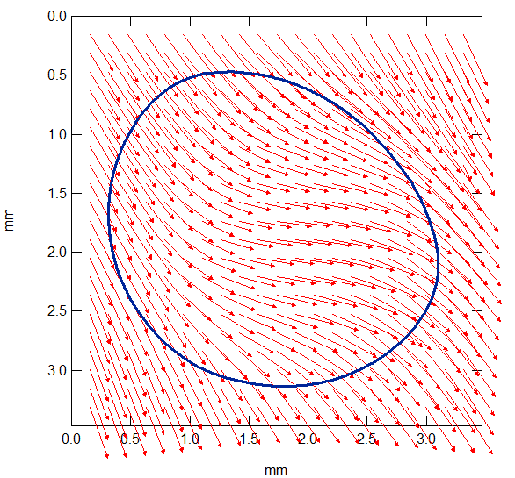
Unsteady-state friction of rubber under curvilinear sliding motions:
the role of memory effects
Vincenzo Fazio, Vito Acito, Christian Frétigny & Antoine Chateauminois
Soft Matter Sciences & Engineering Laboratory (SIMM), ESPCI, Paris
JMC 17 August, 27th 2021

Slide 2

Introduction
Perturbation of a frictional interface by a change in the direction of the driving motion
Change in the orientation of the friction force ?
t₂
t₁
F_{T}
Imposed
Sliding trajectory
t₀
?
F_{T}
?
Rectilinear sliding
Broken line sliding trajectory
Memory effects involved in the reorientation of the friction force?
Ex: velocity step
state-and-rate friction model (Rice & Ruina, 1983)
Ruina, J Geophys Res 1983

Slide 3
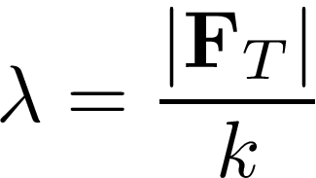




Broken line trajectories : the point contact as a primer
The slider follows a tractrix curve on the moving substrate
Tribo-elastic length
Isotropic stiffness k
R(t)
λ
r(t)
Y
X
Y
θ
X
Gradual reorientation of the friction force applied to the point contact after the change in the direction of the imposed motion
Trajectory of the moving substrate

Slide 4


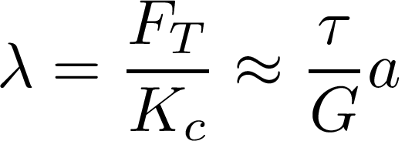

Broken line trajectories : finite size contact
Glass / PDMS single asperity contact
Components F_{x} , F_{y} of the lateral force
Displacement/velocity fields at the surface of the PDMS substrate
Glass lens
R=12.9 mm
2a
Resolution=70 µm
PDMS substrate
Imposed normal force ( ~ 1 N) and driving velocity (0.001-0.1 mm s⁻¹)
Surface marked
PDMS substrate
Contact size a
Tribo-elastic length arises from the elasticity of the rubber substrate

Slide 5


Broken line trajectories : macroscopic friction force
Magnitude of the friction force
Stick-slip phenomenon induced by the trajectory when θ > π/2
Orientation of the friction force
Magnitude of the sliding velocity

Slide 6
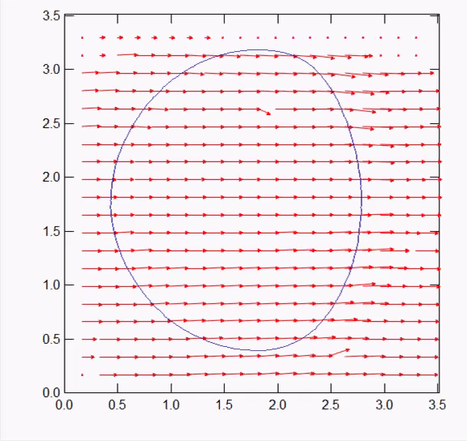

Broken line trajectories : local interfacial velocity
Sliding velocity field
mm
1
1
mm
Orientation of friction force is correlated to the average orientation of the local sliding velocity within the contact
Frictional stress is independent on the contact pressure
Chateauminois et al, EPJE 2008, Nguyen et al, J Adh 2011
Locally, the frictional stress is aligned with respect to the sliding velocity

Slide 7
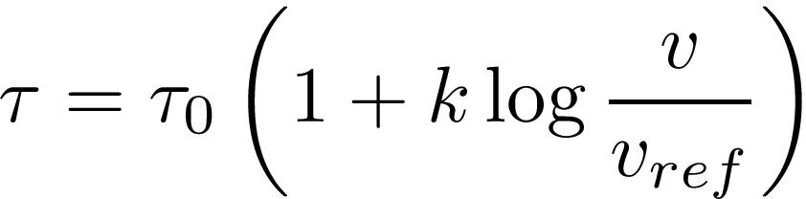


Unsteady state friction model
Hyp: Interfacial shear stress is oriented along the local interfacial velocity
Problem solved within the framework of linear elasticity
Pressure independent friction law
Logarithmic velocity dependence of the frictional stress
Full sliding conditions
Time-dependent interfacial velocity and frictional stress fields
Broken line experiment
Contact radius
Reorientation of the friction force induced by sliding heterogeneities within the contact

Slide 8


Circular sliding trajectories
Orientation of the friction force depends on L/a
Orientation of the friction force
α
F_{T}
Partial sliding when
O
3.5
L
3.0
2.5
2.0
1.5
1.0
0.5
Partial
slip
Full
sliding
0.0
0.0
0.5
1.0
1.5
2.0
2.5
3.0
3.5
Loss of symmetry due to the curvature of the trajectory

Slide 9

Peridodic sine wave motions: phase diagram
y
A
x
1.3 < a < 2 mm
1 < Λ < 6 mm
0.1 < A < 3 mm
Λ
Point contact
theoretical
stick-slip regime
Stick-slip induced by the trajectory
Stick-slip driven by the curvature of the trajectory:
Continous sliding
regime

Slide 10
Friction force : orientation
Continuous sliding regime
A=2 mm
Λ=3 mm
A=0.4 mm
0.4
Y (mm)
-0.4
0
1
2
3
4
5
X (mm)
X (mm)
Friction force can never be tangent to the imposed motion

Slide 11
Velocity step under rectilinear motion
Local interfacial velocity profiles
Magnitude of the friction force
0.001 mm s⁻¹ → 0.01 mm s⁻¹
vt/a₀ ↑
vt/a₀ ↑
0.01 mm s⁻¹ → 0.001 mm s⁻¹

Slide 12


Conclusions
Glass/rubber contact interface perturbed by non rectilinear sliding motions & velocity steps
Heterogeneous deformation of the interface in the contact control the frictional stress and the macroscopic friction force
Friction force no longer tangent to the sliding trajectory
Stick slip phenomenon induced by the trajectory
Simple contact model based on the only assumption that the shear stress is oriented along the local interfacial velocity
→ Finite size effects need to be accounted for in the description of the transient regime
Especially relevant to soft materials
highly curved trajectories
→ Transient frictional regime involves a characteristic length
Description of the sliding heterogeneities at the local scale
→ physical substance to memory effects embedded in state-and-rate friction model

